Slide 1
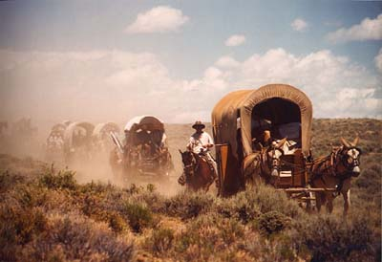
Americans Move Westward
Aim: How did improvements in travel help Americans move West?

Slide 2
Census
What is a census?
Census – official count of a population.
1790 Census:
Population of 4 million people in U.S.
Most lived east of Appalachian Mountains & within a few hundred miles of the Atlantic coast.
1820 Census:
Population of 10 million people in U.S.
Nearly 2 million people living west of Appalachian Mountains.

Slide 3
Traveling West
Settlers had been moving steadily westward since the 1600s.
By 1820, so many people had moved west that the population in some of the original (13) states had actually declined.
As the young nation grew, Americans saw an urgent need to improve transportation, both on water and over land.
Why do you think transportation needed to be improved?

Slide 5
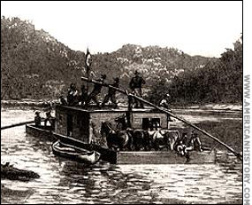
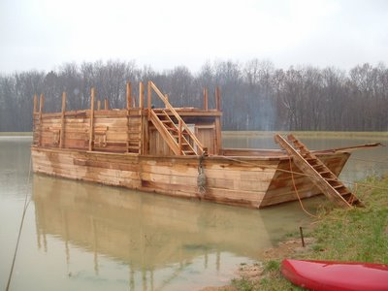
Traveling West
People loaded their animals & wagons onto flatboats & went westward.
Flatboat – boat with a flat bottom used for transporting heavy loads on inland waterways.

Slide 6
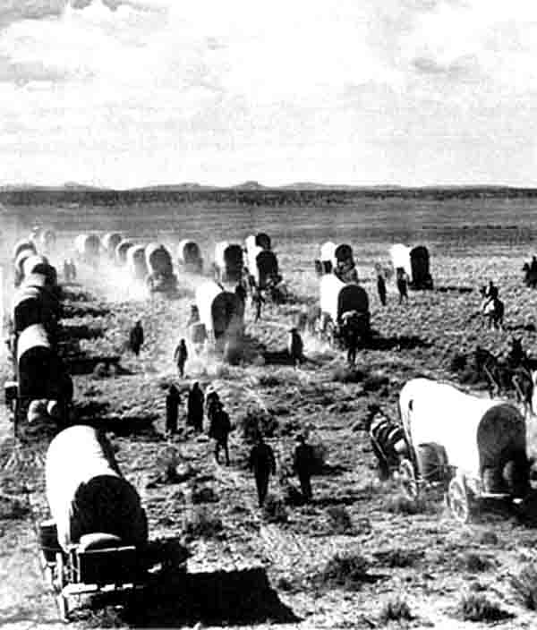
New States
Before long, some western territories had populations large enough to apply for statehood.
Between 1792 & 1819, eight states joined the Union:
Kentucky (1792)
Tennessee (1796)
Ohio (1803)
Louisiana (1812)
Indiana (1816)
Mississippi (1817)
Illinois (1818)
Alabama (1819)

Slide 7
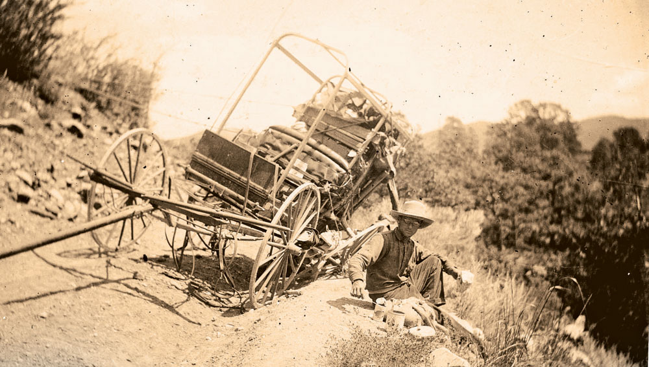
Improvements to Roads
Settlers faced difficult journeys to the west.
Narrow trails (one wagon wide)
Trails led through muddy swamps
Tree stumps stuck up through road and broken axles on wagons

Slide 8
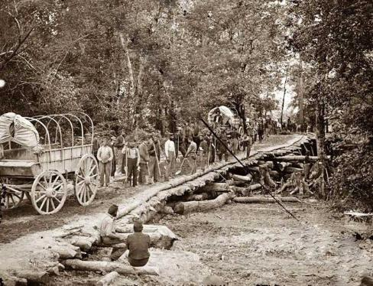
Improvements to Roads
Turnpikes were dirt and gravel roads where a toll was collected.
At various points along road, a pole blocked the road. After a wagon driver paid a toll, a worker would move the pole and let the wagon pass.
Fees collected
helped pay for
construction of
roads.

Slide 9
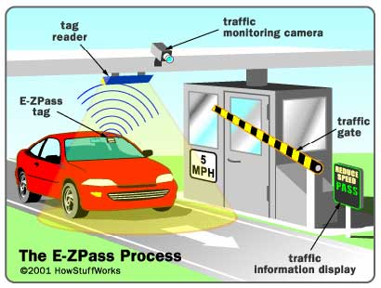
Modern Day Toll Booth

Slide 10
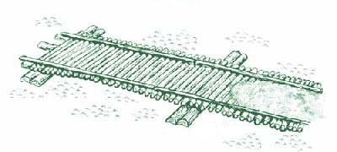
Early Roads
Dirt roads caused wagons to sink in the mud when it rained.
Gravel and stone roads were built to avoid these problems.
Corduroy roads, which were roads made out of logs, were built in swampy areas. These roads made for a very noisy and bumpy ride.

Slide 11
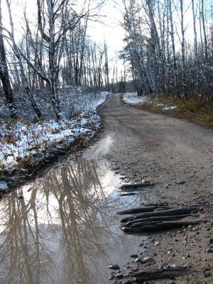
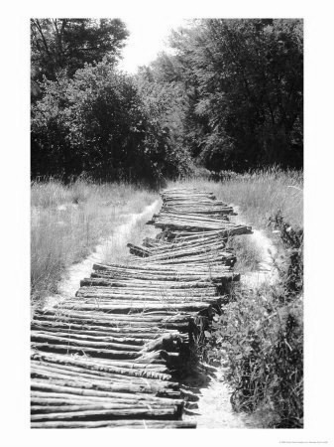
Problem (Muddy Roads)
Solution (Corduroy Roads)

Slide 12
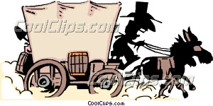
The National Road
In 1806, for the first time, Congress approved funds for a national road.
Road was to run from Cumberland, MD to Wheeling, VA.
Construction started in 1811 but was not complete until 1818 due to War of 1812.
Settlers used the national road to drive their wagons west.

Slide 13
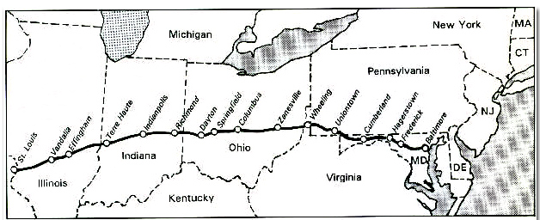
The National Road

Slide 14
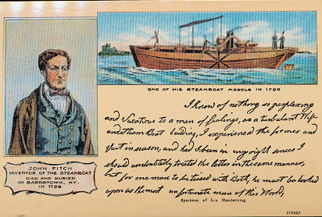
Steam Transport
The steam engine opened a new era in river travel.
In 1787, John Fitch showed how a steam engine could power a boat.
Fitch opened a
ferry service on the
Delaware River,
but few people
used it and he
went out of
business.

Slide 15
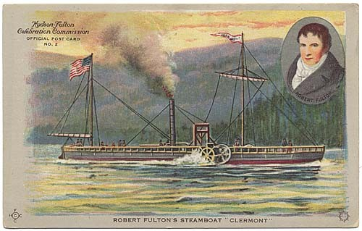
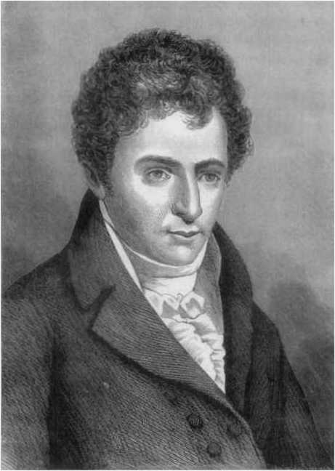
Steam Transport
Robert Fulton built on Fitch’s idea.
In 1807, Fulton launches his own steamboat, the Clermont, on the Hudson River.
Carried passengers from NY City to Albany and back. The 300 mile trip took 62 hours – a record time.

Slide 16
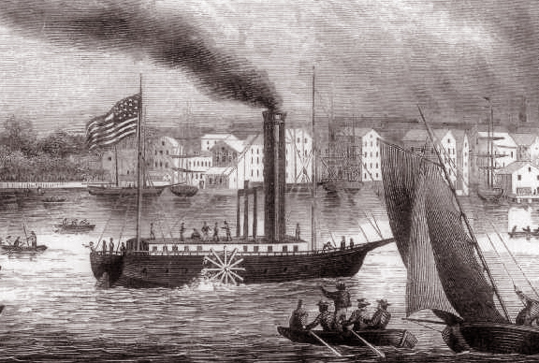
The Age of Steamboats
Why do you think steamboats were important?
Flatboat travel downstream from Pittsburgh to New Orleans in 6 weeks, but upstream took 17 weeks.
Steamboats revolutionized travel in the west.
Gave farmers &
merchants a cheaper
way of moving goods.

Slide 17
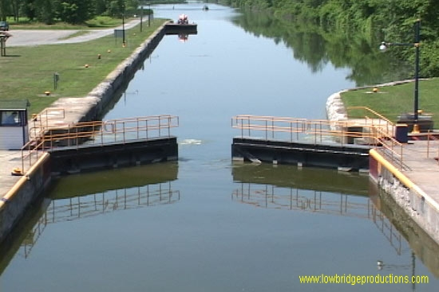
The Canal Boom
New Yorkers have bold idea to build a canal linking the Great Lakes with the Mohawk & Hudson Rivers.
The Erie Canal would let western farmers ship their goods to the port of New York.

Slide 19
The Erie Canal was an instant success.
Why do you think the canal was successful?
Cost of shipping goods now decreased.
Success lead other states to build canals.
Created vital economic ties between western farms and eastern cities.

